Slide 1




NIFTY Nerds
HUMAN RESOURCE MANAGEMENT SYSTEM

Slide 2


nifty nerds
problem statement
HUMAN RESOURCE MANAGEMENT SYSTEM
This problem involves the design and development of a Human Resource Management System (HRMS) that streamlines HR-related tasks and processes within an organization, aiming to improve efficiency and facilitate employee management.

Slide 3




NIFTY NERDS
aBOUT US
"Welcome to Nifty Nerds HR Management System. At Nifty Nerds, we believe that every organization's success is built on the shoulders of its exceptional team members. Our HR system is the key to unlocking the true potential of your workforce. With our cutting-edge technology and user-friendly interface, we empower you to streamline your HR processes, from recruitment to employee development. Join us on a journey of simplified HR management, where every employee is a valued asset, and every task is as easy as pie.

Slide 4

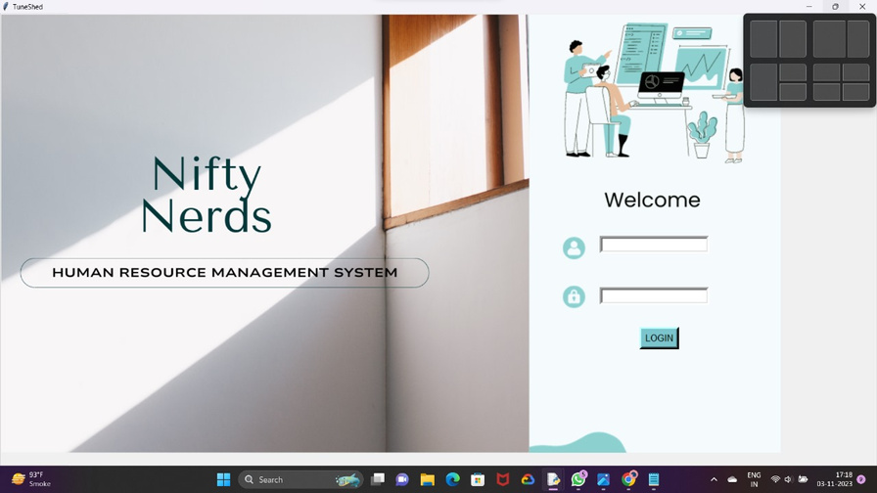
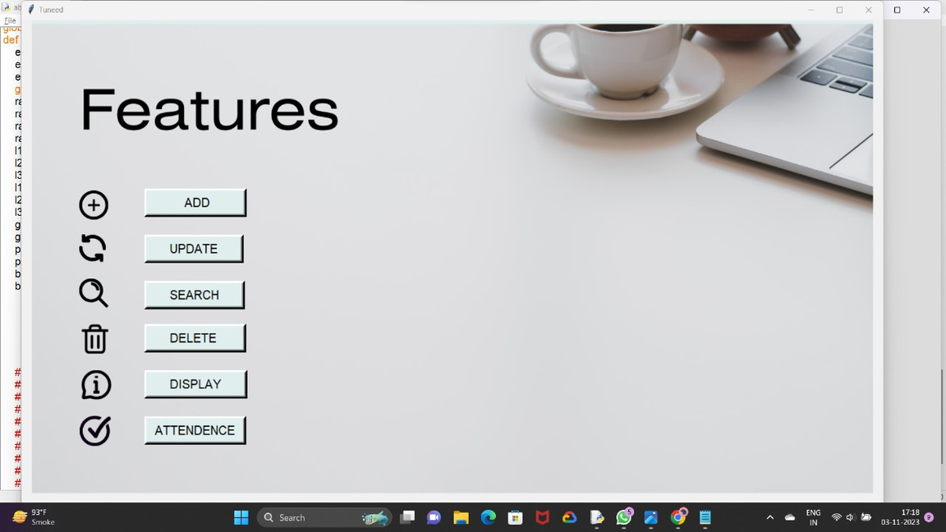
nifty NERDS
OUR INTERFACE
We have a User-Friendly Graphical Interface having ample of functionality. Our design philosophy is all about simplicity, ensuring that users of all backgrounds can navigate effortlessly. But simplicity doesn't mean sacrificing features. We've packed ample functionality under the hood.

Slide 5
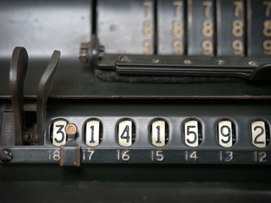





FEATURES
nifty NERDS
ADD EMPLOYEE DETAILS
UPDATE EMPLOYEE DETAILS
SEARCH EMPLOYEE DETAILS
DELETE EMPLOYEE DETAILS
DISPLAY EMPLOYEE DETAILS
ATTENDANCE EMPLOYEE DETAILS

Slide 6


nifty NERDS
Our functionality
1.ADD EMPLOYEE DETAILS
Here, the HR can add details like
Employee ID, Name, Designation, Department,
Salary, Email ID, Date of Birth,
Address and Mobile NO.
2.UPDATE EMPLOYEE DETAILS
Here, the HR can update details like
Employee ID, Name, Date of Birth,
Address and Mobile NO.
3.SEARCH EMPLOYEE DETAILS
Here, the HR can search details of the Employee
by entering Name or Employee ID of the Employee.

Slide 7

nifty NERDS
Our functionality
4.DELETE EMPLOYEE DETAILS
Here, the HR can delete all the information of an Employee by entering the Employee ID.
5.DISPLAY EMPLOYEE DETAILS
Here, the HR can display all the Employee information by just clicking on one button.
6.ATTENDANCE EMPLOYEE DETAILS
Here, the HR can mark absent or present of any Employee by entering the Employee ID and selecting the date.

Slide 8





nifty NERDS
Meet Our Team
SMITH DOSHI
GARGEE RAI
TANISH JAIN
KRISHNA CHANDAK
MANAN GANDHI
B.SC (1st SEM)
B.Tech (1st SEM)
B.SC (1st SEM)
B.SC (1st SEM)
B.SC (1st SEM)

Slide 9
nifty NERDS
ROLES
CO-ORDINATER
PYTHON DEVELOPER
MYSQL
TKINTER
PYTHON DEVELOPER
MYSQL
SMITH DOSHI
KRISHNA CHANDAK
PYTHON DEVELOPER
MYSQL
TKINTER
PYTHON DEVELOPER
TKINTER
MANAN GANDHI
GARGEE RAI
DESIGNER
PYTHON DEVELOPER
TANISH JAIN

Slide 10

nifty NERDS

